Slide 1
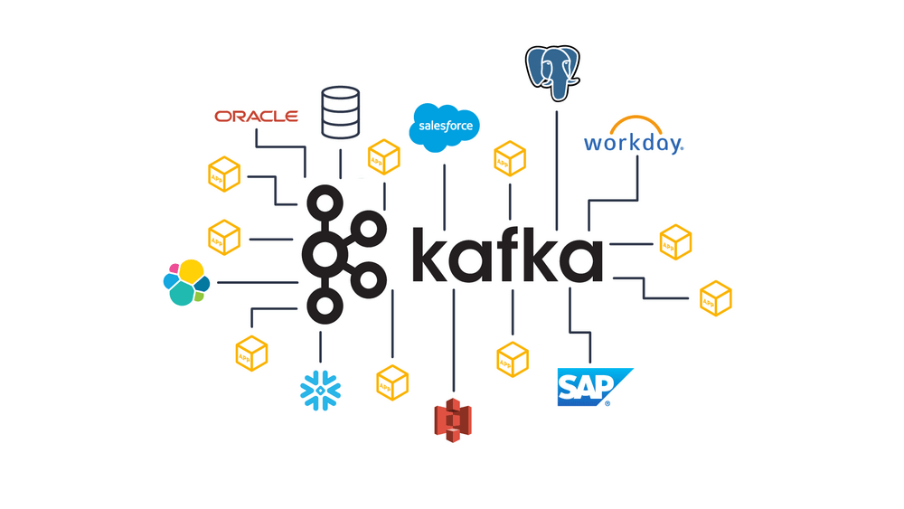

Apache Kafka
Presentation: Febin malik

Slide 2

Agenda
We will cover these skills:
Apache Kafka Introduction And Fundamentals

Slide 3
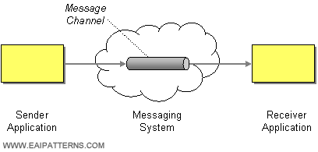
What is a Messaging System?
A Messaging System is responsible for transferring data from one application to another, so the applications can focus on data, but not worry about how to share it. Distributed messaging is based on the concept of reliable message queuing. Messages are queued asynchronously between client applications and messaging system. Two types of messaging patterns are available − one is point to point and the other is publish-subscribe (pub-sub) messaging system. Most of the messaging patterns follow pub-sub.
Point to Point Messaging System
In this messaging system, messages continue to remain in a queue. More than one consumer can consume the messages in the queue but only one consumer can consume a particular message.
After the consumer reads the message in the queue, the message disappears from that queue.
Publish-Subscribe Messaging System
In this messaging system, messages continue to remain in a Topic. Contrary to Point to point messaging system, consumers can take more than one topic and consume every message in that topic. Message producers are known as publishers and consumers are known as subscribers.

Slide 4
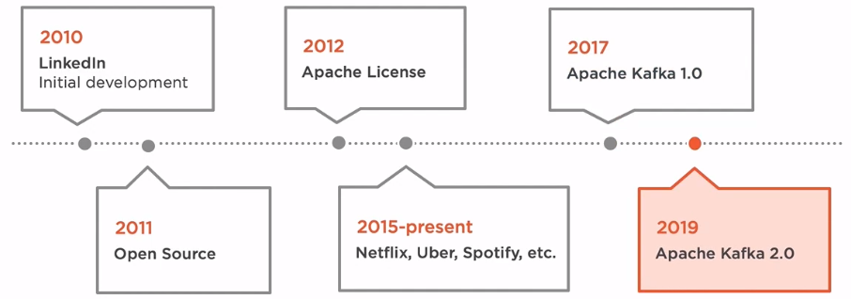
History of Apache Kafka
Previously, LinkedIn was facing the issue of low latency ingestion of huge amount of data from the website into a lambda architecture which could be able to process real-time events.
As a solution, Apache Kafka was developed in the year 2010, since none of the solutions was available to deal with this drawback, before.

Slide 5
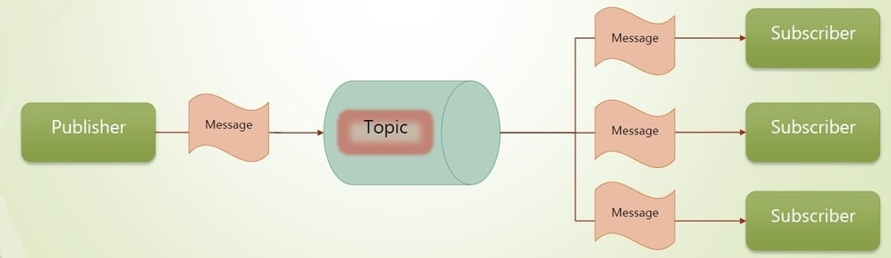
What is Kafka?
Apache Kafka is a fast, scalable, fault-tolerant messaging system which enables communication between producers and consumers using message-based topics. In simple words, it designs a platform for high-end new generation distributed applications.

Slide 6

Why Apache Kafka?
Apache Kafka is capable of handling millions of data or messages per second.
Apache Kafka works as a mediator between the source system and the target system. Thus, the source system (producer) data is sent to the Apache Kafka, where it decouples the data, and the target system (consumer) consumes the data from Kafka.
Apache Kafka is having extremely high performance, i.e., it has really low latency value less than 10ms which proves it as a well-versed software.
Apache Kafka has a resilient architecture which has resolved unusual complications in data sharing.
Organizations such as NETFLIX, UBER, Walmart, etc. and over thousands of such firms make use of Apache Kafka.
Apache Kafka is able to maintain the fault-tolerance. Fault-tolerance means that sometimes a consumer successfully consumes the message that was delivered by the producer. But, the consumer fails to process the message back due to backend database failure, or due to presence of a bug in the consumer code. In such a situation, the consumer is unable to consume the message again. Consequently, Apache Kafka has resolved the problem by reprocessing the data.
Learning Kafka is a good source of income. So, those who wish to raise their income in future in IT sector can learn

Slide 7
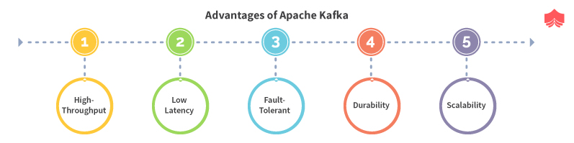
Benefits of Kafka
Reliability − Kafka is distributed, partitioned, replicated and fault tolerance.
Scalability − Kafka messaging system scales easily without down time..
Durability − Kafka uses Distributed commit log which means messages persists on disk as fast as possible, hence it is durable
Performance − Kafka has high throughput for both publishing and subscribing messages. It maintains stable performance even many TB of messages are stored.

Slide 8
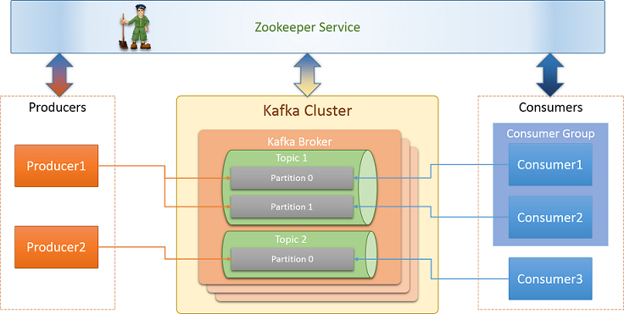
Kafka Components

Slide 9
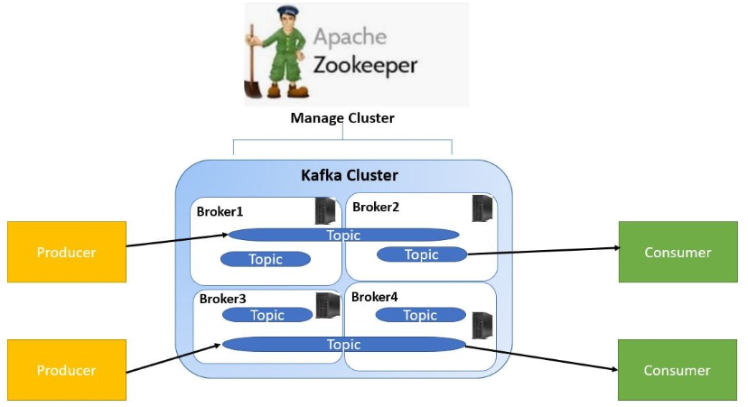
Zookeeper:
Zookeeper is a prerequisite for Kafka. Kafka is a distributed system, and it uses Zookeeper for coordination and to track the status of Kafka cluster nodes. It also keeps track of Kafka topics, partitions, offsets, etc.
Kafka Broker:
The Kafka Broker is nothing but just a server. In simple word, A broker is just an intermediate entity that helps in message exchanges between a producer and a consumer. For Kafka Producer, it acts as a receiver, and for Kafka Consumer, it acts as a sender. In the Kafka cluster, there can be one or more Kafka brokers.
Kafka Cluster:
A cluster is a common terminology in the distributed computing system. It is nothing but just a group of computers that are working for a common purpose. Kafka is also a distributed system, so it also has a cluster having a group of servers called brokers.
There can be one or more brokers in the Kafka cluster.
Single Broker Cluster: The Kafka cluster having only one broker is called Single Broker Cluster.
Multi-Broker Cluster: The Kafka cluster having two or more brokers is called Multi-Broker Cluster.

Slide 10
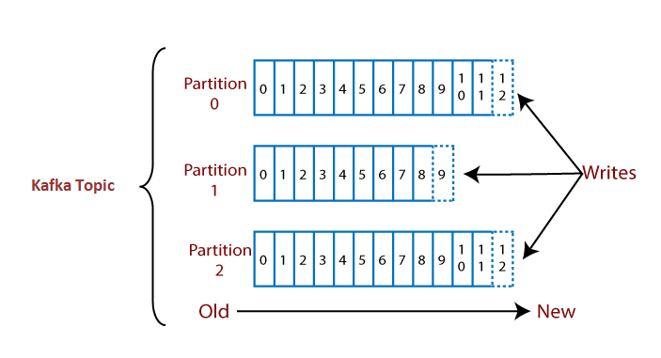
Kafka Topics
Note: The data once written to a partition can never be changed. It is immutable. The offset value always remains in an incremental state, it never goes back to an empty space. Also, the data is kept in a partition for a limited time only.
Basically, how Kafka stores and organizes messages across its system and essentially a collection of messages are Topics. In addition, we can replicate and partition Topics. Here, replicate refers to copies and partition refers to the division. Also, visualize them as logs wherein, Kafka stores messages. However, this ability to replicate and partitioning topics is one of the factors that enable Kafka’s fault tolerance and scalability.
Partitions:
A topic is split into several parts which are known as the partitions of the topic. These partitions are separated in an order. The data content gets stored in the partitions within the topic. Therefore, while creating a topic, we need to specify the number of partitions(the number is arbitrary and can be changed later). Each message gets stored into partitions with an incremental id known as its Offset value. The order of the offset value is guaranteed within the partition only and not across the partition. The offsets for a partition are infinite.
Suppose, a topic containing three partitions 0,1 and 2. Each partition has different offset numbers. The data is distributed among each offset in each partition where data in offset 1 of Partition 0 does not have any relation with the data in offset 1 of Partition1. But, data in offset 1of Partition 0 is inter-related with the data contained in offset 2 of Partition0.
Replicas are nothing but backups of a partition. Replicas are never read or write data. They are used to prevent data loss.

Slide 11
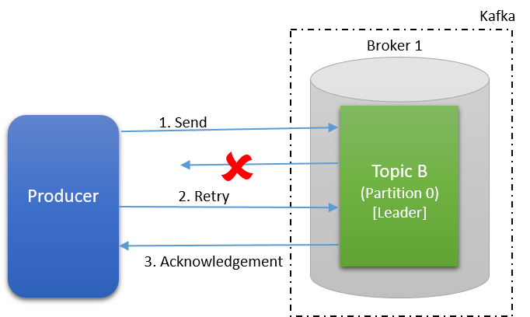
Kafka Producer
Producers are the publisher of messages to one or more Kafka topics. Producers send data to Kafka brokers. Every time a producer pub-llisten a message to a broker, the broker simply appends the message to the last segment file. Actually, the message will be appended to a partition. Producer can also send messages to a partition of their choice.
How does the producer write data to the cluster?
A producer uses following strategie’s to write data to the cluster:
Message Keys
Acknowledgment
Message Keys:
Apache Kafka enables the concept of the key to send the messages in a specific order. The key enables the producer with two choices, i.e., either to send data to each partition (automatically) or send data to a specific partition only. Sending data to some specific partitions is possible with the message keys. If the producers apply key over the data, that data will always be sent to the same partition always. But, if the producer does not apply the key while writing the data, it will be sent in a round-robin manner. This process is called load balancing. In Kafka, load balancing is done when the producer writes data to the Kafka topic without specifying any key, Kafka distributes little-little bit data to each partition. Therefore, a message key can be a string, number, or anything as we wish.
There are two ways to know that the data is sent with or without a key:
If the value of key=NULL, it means that the data is sent without a key. Thus, it will be distributed in a round-robin manner (i.e., distributed to each partition).
If the value of the key!=NULL, it means the key is attached with the data, and thus all messages will always be delivered to the same partition.

Slide 12
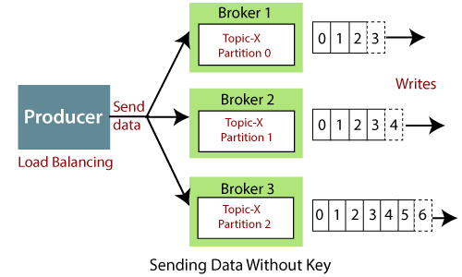
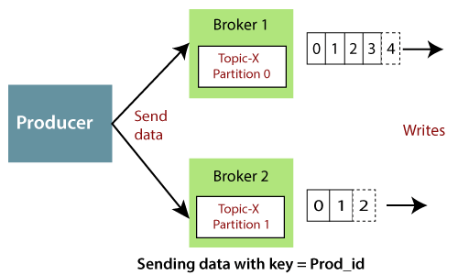
Let's see an example
Consider a scenario where a producer writes data to the Kafka cluster, and the data is written without specifying the key. So, the data gets distributed among each partition of Topic-T under each broker, i.e., Broker 1, Broker2, and Broker 3.
Consider another scenario where a producer specifies a key as Prod_id. So, data of Prod_id_1(say) will always be sent to partition 0 under Broker 1, and data of Prod_id_2 will always be in partition 1 under Broker 2. Thus, the data will not be distributed to each partition after applying the key (as saw in the above scenario).

Slide 13
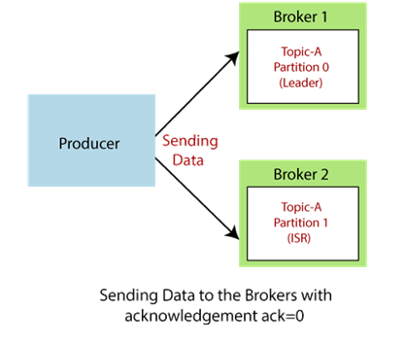
Acknowledgment:
In order to write data to the Kafka cluster, the producer has another choice of acknowledgment. It means the producer can get a confirmation of its data writes by receiving the following acknowledgments:
acks=0: This means that the producer sends the data to the broker but does not wait for the acknowledgement. This leads to possible data loss because without confirming that the data is successfully sent to the broker or may be the broker is down, it sends another one.
acks=1: This means that the producer will wait for the leader's acknowledgement. The leader asks the broker whether it successfully received the data, and then returns feedback to the producer. In such case, there is limited data loss only.
acks=all: Here, the acknowledgment is done by both the leader and its followers. When they successfully acknowledge the data, it means the data is successfully received. In this case, there is no data loss.
Let's see an example:
Suppose, a producer writes data to Broker1, Broker 2, and Broker 3.
Case1: Producer sends data to each of the Broker, but not receiving any acknowledgment. Therefore, there can be a severe data loss, and the correct data could not be conveyed to the consumers.

Slide 14
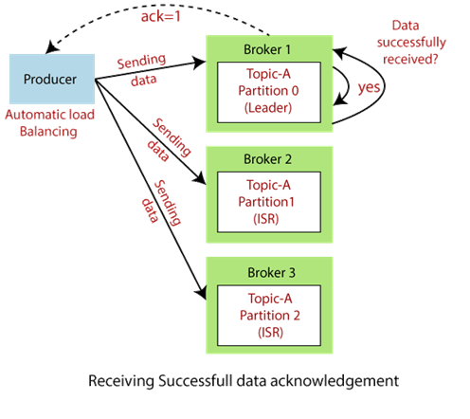
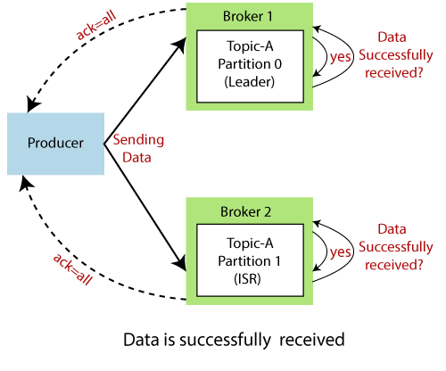
Case2: The producers send data to the brokers. Broker 1 holds the leader. Thus, the leader asks Broker 1 whether it has successfully received data. After receiving the Broker's confirmation, the leader sends the feedback to the Producer with ack=1.
Case3: The producers send data to each broker. Now, the leader and its replica/ISR will ask their respective brokers about the data. Finally, acknowledge the producer with the feedback.

Slide 15
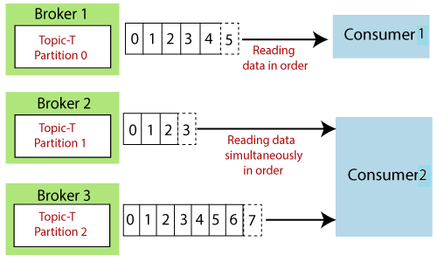
Consumer and Consumer Groups
A consumer is the one that consumes or reads data from the Kafka cluster via a topic. A consumer also knows that from which broker, it should read the data. The consumer reads the data within each partition in an orderly manner. It means that the consumer is not supposed to read data from offset 1 before reading from offset 0. Also, a consumer can easily read data from multiple brokers at the same time
For example, two consumers namely, Consumer 1 and Consumer 2 are reading data. Consumer 1 is reading data from Broker 1 in sequential order. On the other hand, Consumer 2 is simultaneously reading data from Broker 2 as well as Broker 3 in order.
Note: Consumer 2 is reading data parallelly from Broker 2 and Broker 3. Thus, offset 2 under Broker 2 does not have any connection with the data contained in offset 2 under Broker 3
Consumer Groups:
A consumer group is a group of multiple consumers which visions to an application basically. Each consumer present in a group reads data directly from the exclusive partitions. In case, the number of consumers are more than the number of partitions, some of the consumers will be in an inactive state. Somehow, if we lose any active consumer within the group then the inactive one can takeover and will come in an active state to read the data.

Slide 16
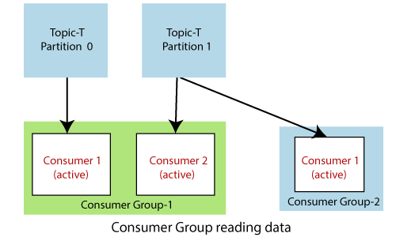
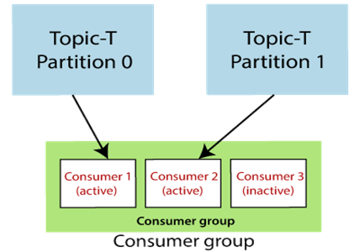
How to decide which consumer should read data first and from which partition?
For such decisions, consumers within a group automatically use a 'GroupCoordinator' and one 'ConsumerCoordinator', which assigns a consumer to a partition. This feature is already implemented in the Kafka. Therefore, the user does not need to worry about it.
Let's see the below examples.
Example 1
Consider two groups of consumers, i.e., Consumer Group-1 and Consumer Group-2. Both the consumers of Group 1 are reading data together but from different partitions. Both the consumers of Group 1 will remain in an active state because they are reading the data parallelly.
On the other hand, Consumer 1 of Group 2 is also reading the data from Partition 1 under Topic-T. Here, also the consumer is present in an active state because it belongs to Group 2.
Example 2
Consider another scenario where a consumer group has three consumers. Consumer 1 and Consumer 2 are present in an active state. Consumer 1 is reading data from Partition 0 and Consumer 2 from Partition 1. As, there are only two topic-partitions available, but three consumers. Thus, Consumer 3 will remain in an inactive state until any of the active consumer leaves.

Slide 17
Thank You
Febin malik
9656668856

